Slide 1


Restaurants Analysis
By Unmesh Sadawarte

Slide 2

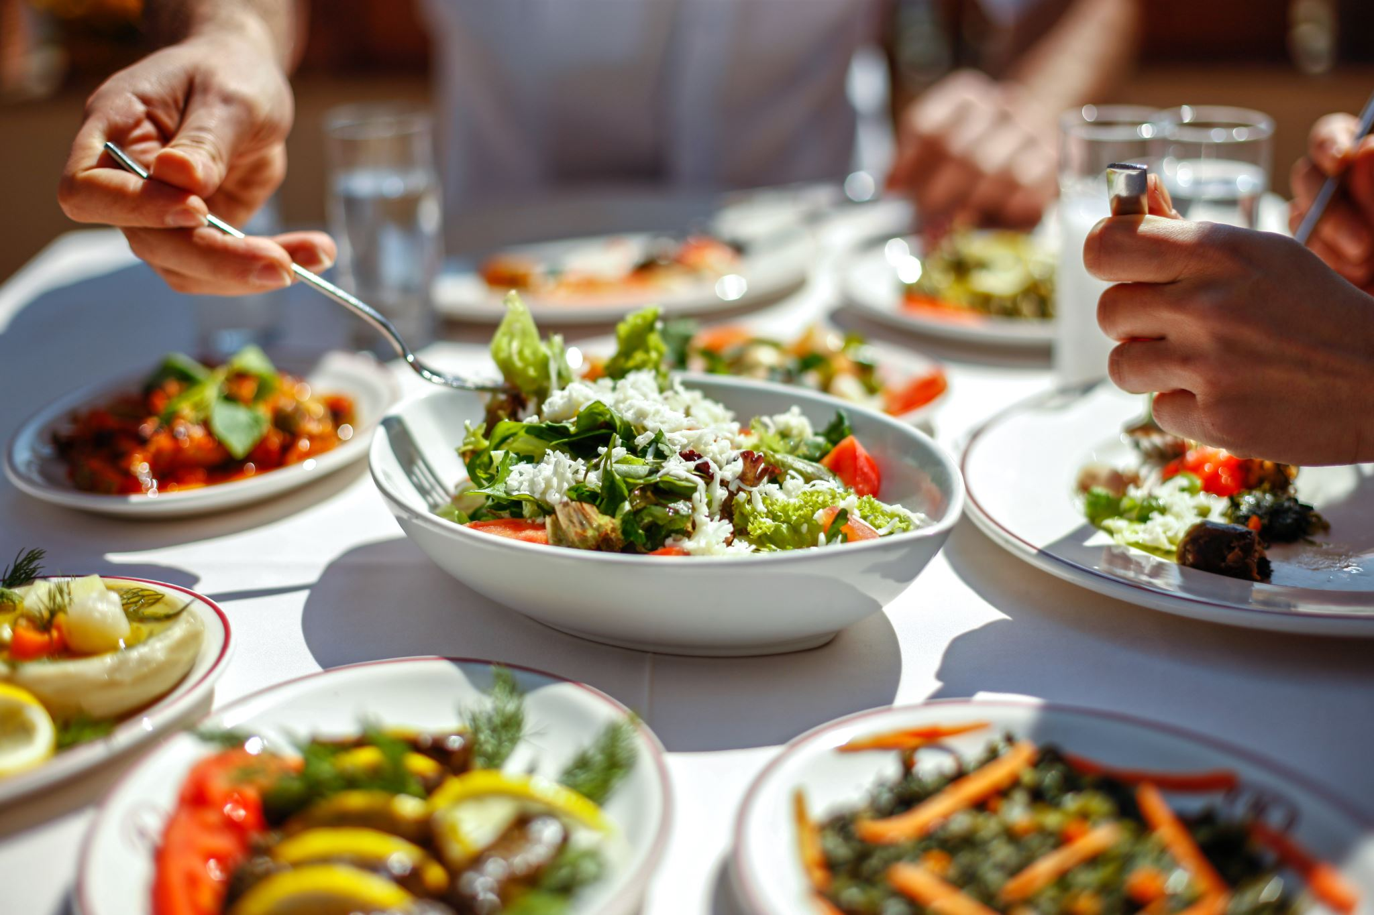
Zomato, originally Foodiebay, is an Indian restaurant discovery and online food delivery platform founded in 2008
Zomato operates in multiple countries and has achieved significant growth through acquisitions and strategic adaptations.
The Project aims to identify potential areas in specific countries where is can expand and do business.
It also aims to find cuisine trends and analyze the local restaurants capability and popularity.
The platform provides detailed restaurant information, menus, reviews, and ratings, helping users make informed dining decisions while enabling restaurants to reach a wider audience.
Zomato’s business model integrates discovery, delivery, and dining services, offering end-to-end solutions from restaurant search to doorstep delivery and digital table reservations.

Slide 3
Problem Statement
“Zomato, a global restaurant discovery and food delivery platform, aims to strategically expand its restaurant presence across new geographies to strengthen market share and brand visibility.
As a data analyst consultant, your role is to conduct an in-depth analysis of Zomato’s existing restaurant data to identify high-potential markets, cities, and customer segments with lower competition and higher profitability opportunities.”
The objective is to derive actionable insights on:
Market saturation levels and regional dining trends.
Customer preferences, pricing behavior, and service expectations.
Countries and cities offering favorable conditions for new restaurant openings.
This analysis will form the foundation for data-driven strategic recommendations, ensuring Zomato’s future restaurant expansions are aligned with consumer demand, operational feasibility, and sustainable business growth.

Slide 4
Raw Data – Restaurant-level details (name, location, rating, cost, votes, cuisines).
Country Description – Country codes, names, and currency conversion rates.
Total Attributes (Columns): 15
Important Variables:
Country, City, Cuisines, Average Cost for Two, Price Range, Rating, Votes, Has Table Booking, Has Online Delivery.
Data Overview
Had Data of 9551 Restaurants across 15 countries and 140 cities with 9542 sets of cuisines
Majority of those restaurants were Indian.
ZData Used:
Data cleaning and preprocessing
Added a column of country according to its country_code using XLOOKUP
Filled Missing values of Longitude and Latitude according to provided city and country.
Deleted 9 empty rows of cuisines.
Gave each column its appropriate data-type.
Separated city column from locality .
Seperated Year from date_key_opening using TEXT() function

Slide 5


Data Cleaning
Blank spaces filled with means and relevant data. New calculated columns are created like ‘Average price for 2’ with their own currency symbol and an equivalent price in Indian rupee to better understand the price range.

Slide 6
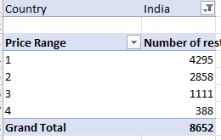
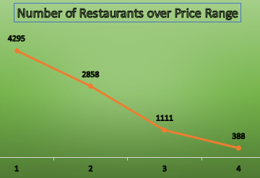
Methodology
1️⃣ Data Preparation
• Merged Raw Data & Country Description
• Cleaned duplicates, handled missing values
• Standardized currencies via XLOOKUP
• Created new derived columns
2️⃣ Data Analysis
• Built Pivot Tables for metrics
• Applied COUNTIFS, AVERAGEIFS, IF formulas
• Evaluated trends in ratings, costs & cuisines
• Measured correlations
3️⃣ Visualization
• Developed dynamic charts & slicers
• Added KPI cards for key metrics
• Maintained consistent Zomato theme
4️⃣ Insights & Recommendations
• Identified high-potential countries
• Recommended cuisines & pricing strategies
• Proposed tech-enabled service improvements
=XLOOKUP(C223,'country description'!$A$2:$A$16,'country description'!$B$2:$B$16,,0)
the majority of restaurants fall within the lower price ranges (1–2), with a sharp decline in count as prices increase. This indicates that Zomato’s existing market is dominated by affordable and mid-range dining options, while premium or high-cost restaurants (Range 3–4) are relatively scarce — suggesting potential for expansion in the upscale segment.

Slide 7
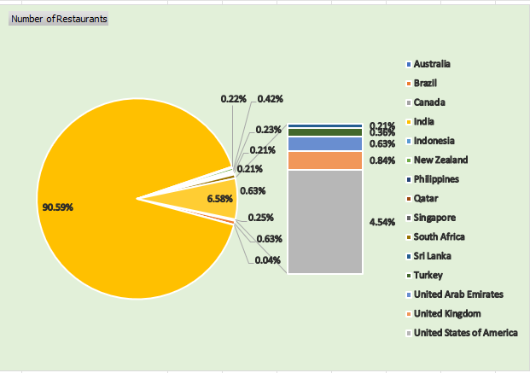
Country-wise Restaurant Distribution
This pie chart reveals that India accounts for 90.59% of all restaurants in the dataset, highlighting an extremely high market concentration in a single country.
Other nations like New Zealand (4.54%) and Brazil (0.84%) have marginal presence, while most remaining countries contribute less than 1% each.
This indicates that Zomato’s current operations are heavily focused in India, suggesting a strong opportunity for global diversification and expansion into underrepresented international markets such as Brazil, Canada, and Australia.

Slide 8
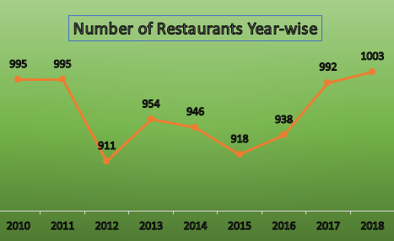
Year-wise Growth Trend
Insight:
The trend shows a slight fluctuation in the number of restaurants opened each year, with a dip around 2012–2015 followed by steady recovery after 2016. The consistent rise from 2016 to 2018, reaching a peak of 1,003 restaurants, indicates renewed growth momentum and stable market expansion in recent years.

Slide 9
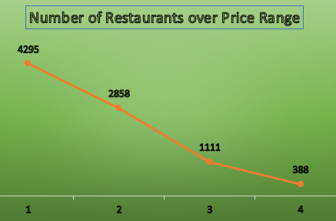
Price Range Distribution
Insight:
The chart reveals a clear inverse relationship between restaurant count and price range.
A majority of restaurants (over 4,200) fall within the lowest price range, indicating a strong market presence in the affordable dining segment.
The number of restaurants significantly decreases as prices rise, with only 388 restaurants in the highest range. This trend suggests that Zomato’s existing markets are largely price-sensitive, favoring budget and mid-range options.
The minimal representation in premium categories highlights a potential opportunity for Zomato to expand into higher-end dining segments where competition is currently lower.

Slide 10
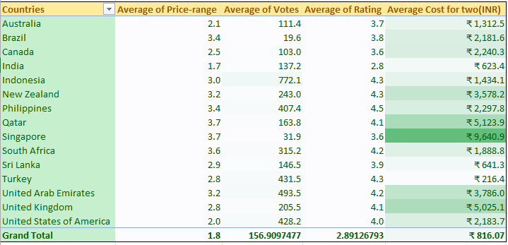
Recommended Countries for Expansion
Brazil (Avg Rating 3.8, Price 3.4, Cost ₹2,182) → High rating with moderate cost; low booking/delivery penetration → under-served.
Canada (3.6 rating, ₹2,240) → Fewer restaurants, decent affordability, zero online/table booking → good new-entry potential.
Australia (3.7 rating, ₹1,313) → Moderate rating, low competition, affordable cost, zero online/table booking → good new-entry potential.
Singapore (3.6 rating, ₹9,641) → High cost but consistently good rating; niche premium opportunity, same delivery conditions as others.
Countries like India and Philippines already have higher % online delivery or table booking, implying mature/competitive markets.

Slide 11
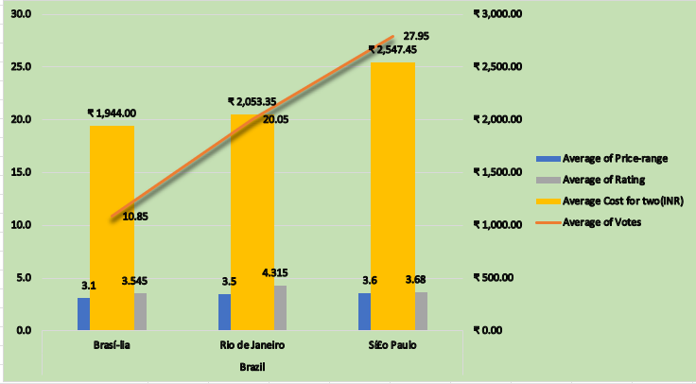
Brazil
A high-spending market (₹2200 average cost-for-two) with strong ratings (≈3.8) and limited online or booking availability.
Cities such as São Paulo and Rio de Janeiro show concentrated demand for premium dining, while Brasília provides scope for upscale yet accessible restaurant models.

Slide 12
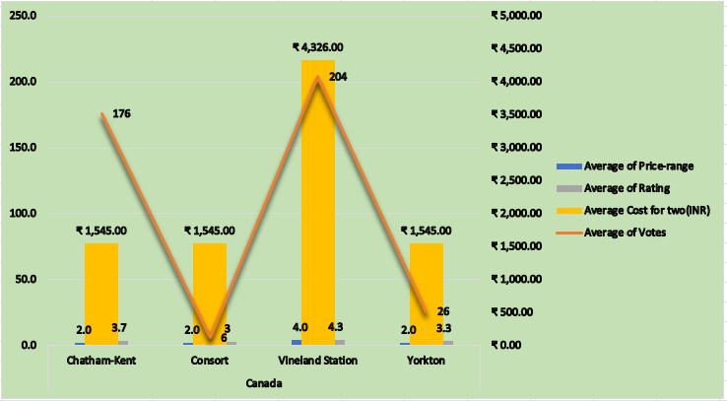
Canada
  Vineland Station and Consort stand out with high customer ratings (≈4.0) and low restaurant density. These regions are characterized by smaller, affluent communities that value quality dining experiences over volume-driven outlets.

Slide 13
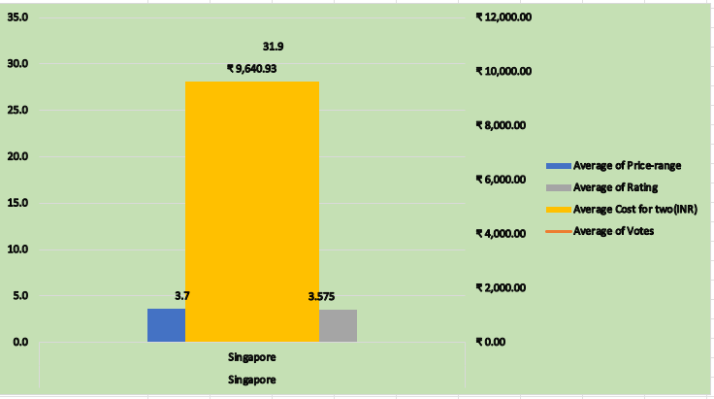
Singapore
The market exhibits very high expenditure levels (₹1,92,819 average cost-for-two) with consistent ratings (~3.8–4.0).
Areas like Downtown Core, Marina Centre, and Bukit Timah serve as viable choices for flagship fine-dining ventures and experiential culinary brands.

Slide 14
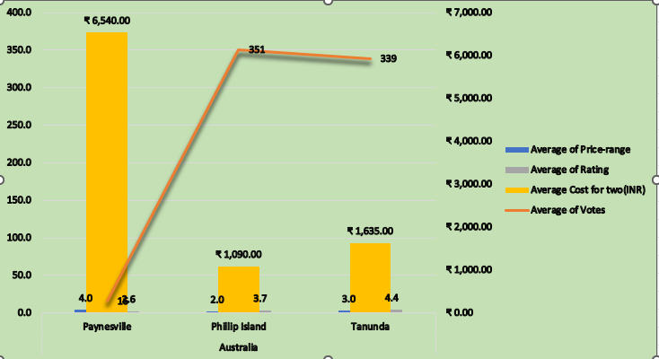
Australia
  Cities such as Paynesville, Phillip Island, and Tanunda combine tourism-driven demand with high affordability and strong average ratings (3.8–4.2). They offer excellent entry points for premium casual or destination dining.

Slide 15
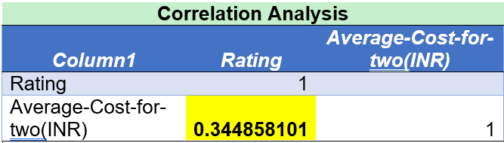
Strategy for pricing
We should keep the rates of cuisine higher . Yes it does affect the ratings of the restaurant but not significantly. As it is shown by this correlation analysis.
The table shows a correlation coefficient of 0.344858101 between Rating and Average-Cost-for-two (INR).
What Does This Mean?
Positive but Weak Correlation (0.34)
  The correlation is positive, meaning that as the cost for two increases, the rating tends to increase slightly.
  However, the value of 0.34 indicates a weak to moderate relationship, not a strong one.
  Higher-priced restaurants tend to have slightly better ratings, possibly due to better service, ambiance, or food quality.
  However, the weak correlation suggests that price alone is not a major driver of ratings—other factors (cuisine, service, location) play a bigger role.
Strategy for Pricing

Slide 16


Strategic Recommendations
Customer Rating Impact:
Restaurants with both online delivery and table booking show a notably higher average rating of 3.60, compared to 2.68 for those without either feature.
This 0.92-point increase indicates that accessibility and convenience directly enhance customer satisfaction and brand loyalty.
Customers prefer establishments that offer flexibility
Cost and Pricing Behavior:
Outlets providing these services also show a significantly lower average cost-for-two (₹5,71,890) compared to ₹46,43,054 for those lacking both.
This contrast reflects an operational pattern — restaurants offering online or booking facilities are typically mid-range to premium casual, while those without such features skew toward exclusive fine-dining with higher pricing and limited accessibility.

Slide 17
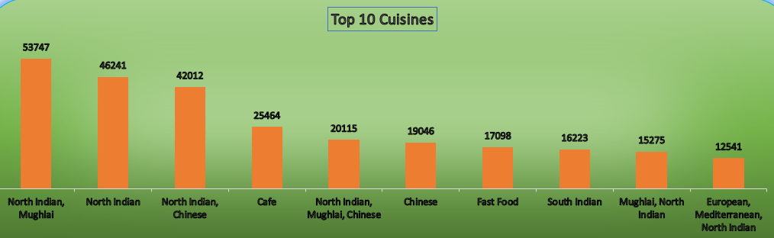
Top Cuisines
Overall Trend:
The most popular cuisines globally are North Indian & Mughlai (53,747 votes), American (5,778 votes), and Sunda–Indonesian (5,514 votes). These cuisines attract the largest customer engagement, indicating broad appeal and familiarity among diverse audiences.
Correlation with Ratings:
Cuisines with high engagement (Indian, American, Mediterranean, Italian) tend to maintain average-to-high ratings (3.5–4.2).
Less popular cuisines, while niche, often show higher per-restaurant ratings due to exclusivity and differentiated dining experiences — particularly in fine-dining markets like Singapore.

Slide 18
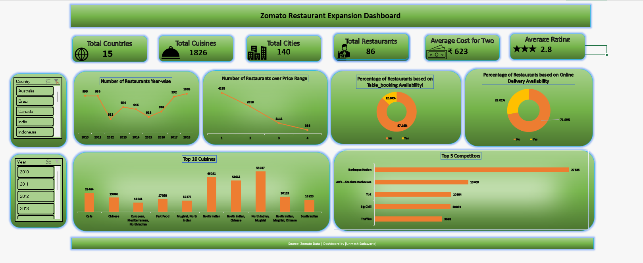
Dashboard :

Slide 19
Recommendations
Markets: Brazil, Canada, and Australia
These countries present strong growth potential with a favorable mix of high customer ratings, moderate operational costs, and limited competition.
Brazil and Canada offer emerging mid-premium dining opportunities, while Australia combines affordability with tourism-driven demand.
Premium Option: Singapore
Singapore represents a mature, high-income market suited for premium or experiential dining concepts.
Expansion here should emphasize brand prestige, exclusivity, and high-quality service standards.
Cuisines: Mediterranean / Italian / Fusion
These cuisines are globally popular, versatile, and perform well in diverse markets such as Brazil, Canada, and Australia.
Incorporating local ingredients or regional twists can enhance customer acceptance and create a unique brand identity.
Fusion menus can help bridge traditional flavors with modern tastes, appealing to urban and experimental diners.
Services: Online Delivery and Table Booking
Data indicates that restaurants offering both online delivery and booking options maintain higher average ratings (3.6★ vs 2.7★).
Implementing both services across new locations will improve customer convenience, increase visibility, and strengthen Zomato’s digital ecosystem.

Slide 20

Conclusion
Conclusion
The analysis highlights strong expansion potential for Zomato in emerging markets like Brazil, Canada, and Australia, supported by favorable customer ratings and low competition.
Premium opportunities exist in Singapore, where high spending aligns with experiential dining demand.
Offering online delivery and table booking services will enhance accessibility and customer satisfaction.
Overall, a data-driven expansion strategy focusing on affordability, quality, and service innovation will ensure sustainable global growth for Zomato.

